Slide 1
Week 3 Lab Exercise
Eddie Flores
MSDS610 – Data Engineering

Slide 2
Data Pipeline Diagram
Source Data
Extract
Transform
Load
Apache Spark
Data Cleaning
Missing Data
Remove Duplicates
Handle Outliers
PostgreSQL
Database: MSDS610
Schema: raw
Table: sales_transaction
Airflow
SQL query to extract raw data
Parquet Files
Processed Data
Final Storage
Normalization
Feature Engineering
Notes:
Parquet is a good choice because of its ability to store large amounts of transactional data efficiently, particularly when queried for column-specific insights.

Slide 3
Pipeline Type
Batch Pipeline:
A batch pipeline is suitable for handling structured, historical sales data since updates are periodic.

Slide 4
Data Quality
Three Potential Data Quality Issues:
Missing Values
The CustomerNo column has 55 missing values
Duplicates
There are 5,200 duplicate rows in the dataset
Outliers
Price: 852 outliers detected using a Z-score threshold of 3.
Quantity: 255 outliers detected using the same Z-score threshold.

Slide 5
Validation and Monitoring of Data Quality
Missing Values
Validation Check:
During the transformation phase, apply null checks using SQL (IS NULL)
Decide whether to impute missing values (e.g., with mean or a placeholder) or drop rows if not critical
Monitoring Approach
Set up alerts to trigger when missing values exceed a specified threshold
Schedule periodic data quality reports to log the occurrence of missing values

Slide 6
Validation and Monitoring of Data Quality
Duplicates
Validation Check:
Apply deduplication using functions like DISTINCT in SQL during the transformation phase.
Ensure that key columns like contain unique values to avoid transactional duplicates.
Monitoring Approach
Maintain logs of how many duplicates are detected and resolved during each pipeline run
If duplicate records surpass a pre-defined threshold, trigger an investigation

Slide 7
Validation and Monitoring of Data Quality
Outliers
Validation Check:
Detect outliers using statistical methods such as Z-scores or domain-specific thresholds
Define rules to cap or correct extreme values or flag them for manual review
Monitoring Approach
Implement anomaly detection dashboards showing outlier trends over time
Generate automated alerts when new outliers deviate significantly from historical patterns

Slide 8
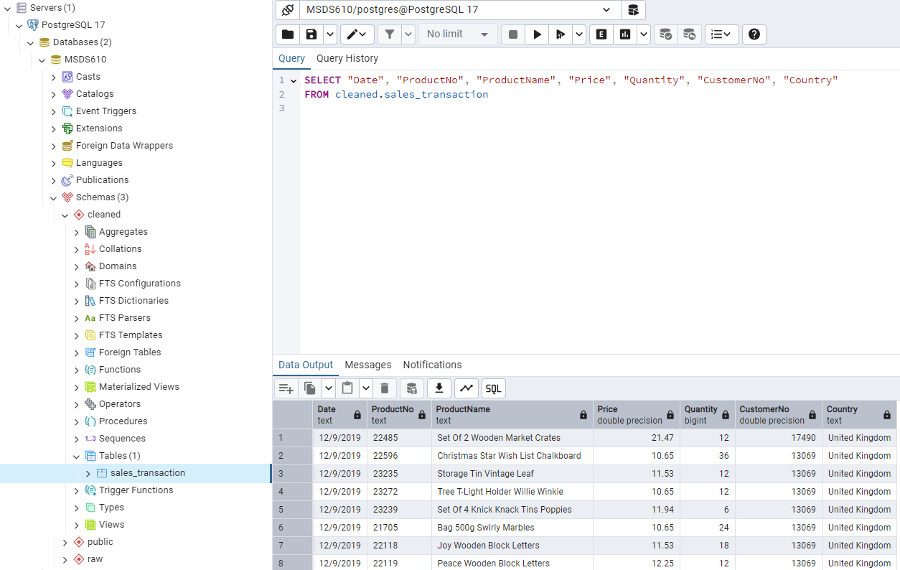
Clean data loaded to cleaned schema

